Slide 1
My Business Website
By
Nurul Hasanah

Slide 2

Kashmir Product and Travel
Craft and More

Slide 3
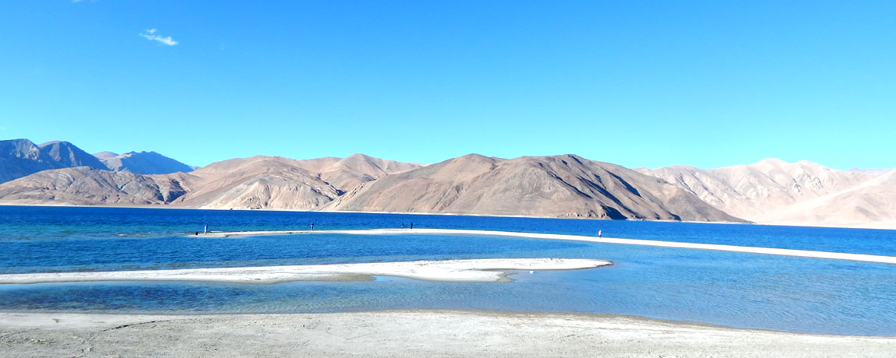
Here is My Website
KASHMIRPRODUCT.html

Slide 4

30% 0ff for all product
On thi Ramadhan

Slide 5
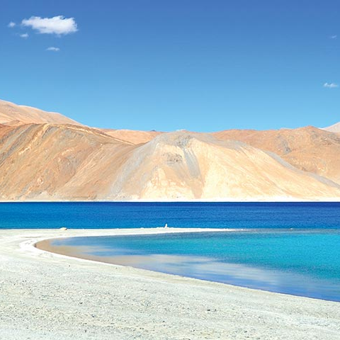
Pangon_ Leh ladakh lake

